Slide 1


International Economics: Theory and Policy
Twelfth Edition
Chapter 14
Exchange Rates and the Foreign Exchange Market: An Asset Approach
Copyright © 2022, 2018, 2015 Pearson Education, Inc. All Rights Reserved
Notes:
If this PowerPoint presentation contains mathematical equations, you may need to check that your computer has the following installed:
1) MathType Plugin
2) Math Player (free versions available)
3) NVDA Reader (free versions available)
Slides in this presentation contain hyperlinks. JAWS users should be able to get a list of links by using INSERT+F7

Slide 2
Learning Objectives
14.1 Relate exchange rate changes to changes in the relative prices of countries’ exports.
14.2 Describe the structure and functions of the foreign exchange market.
14.3 Use exchange rates to calculate and compare returns on assets denominated in different currencies.
14.4 Apply the interest parity condition to find equilibrium exchange rates.
14.5 Find the effects of interest rates and expectation shifts on exchange rates.

Slide 3
Preview
The basics of exchange rates
Exchange rates and international relative prices
Demand and equilibrium in the foreign exchange market
The demand of currency and other assets
A model of foreign exchange markets
role of interest rates on currency deposits/bonds
role of expectations of exchange rates
forward exchange rates and covered interest parity

Slide 4
Definitions of Exchange Rates
Exchange rates are quoted as foreign currency per unit of domestic currency or domestic currency per unit of foreign currency.
How much can be exchanged for one dollar?
How much can be exchanged for one yen?
Exchange rates allow us to denominate the cost or price of a good or service in a common currency.
How much does a Nissan cost?
Or,

Slide 5
Table 14.1 Exchange Rate Quotations (1 of 5)
Currencies
Jun 3 | Currency | DOLLAR Closing Mid | DOLLAR Day’s Change | EURO Closing Mid | EURO Day’s Change | POUND Closing Mid | POUND Day’s Change
Argentina | Argentine Peso | 68.8026 | 0.0953 | 77.1927 | 0.3569 | 86.6673 | 0.3917
Australia | Australian Dollar | 1.4423 | Negative 0.0088 | 1.6181 | Negative 0.0046 | 1.8168 | Negative 0.0053
Bahrain | Bahraini Dinar | 0.3772 | 0.0000 | 0.4231 | 0.0013 | 0.4751 | 0.0014
Bolivia | Bolivian Boliviano | 6.9100 | Blank | 7.7526 | 0.0251 | 8.7042 | 0.0273
Brazil | Brazilian Real | 5.0281 | Negative 0.1935 | 5.6412 | Negative 0.1981 | 6.3336 | Negative 0.2231
Canada | Canadian Dollar | 1.3489 | 0.0001 | 1.5133 | 0.0050 | 1.6991 | 0.0055
Chile | Chilean Peso | 764.9900 | Negative 15.2950 | 858.2761 | Negative 14.3210 | 963.6213 | Negative 16.1809
China | Chinese Yuan | 7.1099 | Negative 0.0006 | 7.9769 | 0.0252 | 8.9560 | 0.0274
Colombia | Colombian Peso | 3579.3300 | Negative 46.9050 | 4015.8094 | Negative 39.4294 | 4508.7106 | Negative 44.7456
Costa Rica | Costa Rican Colon | 577.1050 | 1.7850 | 647.4796 | 4.0960 | 726.9515 | 4.5235
Czech Republic | Czech Koruna | 23.7213 | 0.0004 | 26.6139 | 0.0868 | 29.8805 | 0.0943
Denmark | Danish Krone | 6.6449 | Negative 0.0199 | 7.4552 | 0.0019 | 8.3702 | 0.0012
Egypt | Egyptian Pound | 16.0836 | 0.1097 | 18.0449 | 0.1812 | 20.2598 | 0.2014
Hong Kong | Hong Kong Dollar | 7.7503 | Negative 0.0002 | 8.6953 | 0.0279 | 9.7626 | 0.0303

Slide 6
Table 14.1 Exchange Rate Quotations (2 of 5)
Jun 3 | Currency | DOLLAR Closing Mid | DOLLAR Day’s Change | EURO Closing Mid | EURO Day’s Change | POUND Closing Mid | POUND Day’s Change
Hungary | Hungarian Forint | 306.7205 | Negative 2.1010 | 344.1232 | 1 | 386.3611 | Negative 1.4253
India | Indian Rupee | 75.4700 | 0.1075 | 84.6731 | 0.3948 | 95.0659 | 0.4334
Indonesia | Indonesian Rupiah | 14110.0000 | Negative 322.5000 | 15830.6500 | Negative 309.3157 | 17773.7017 | Negative 349.1678
Israel | Israeli Shekel | 3.4763 | 0.0030 | 3.9002 | 0.0161 | 4.3789 | 0.0176
Japan | Japanese Yen | 108.8250 | 0.2400 | 122.0956 | 0.6644 | 137.0816 | 0.7317
..One Month | Blank | 108.8249 | 0.2399 | 122.0956 | 0.6644 | 137.0816 | 0.7316
..Three Month | Blank | 108.8248 | 0.2397 | 122.0956 | 0.6645 | 137.0815 | 0.7314
..One Year | Blank | 108.8242 | 0.2384 | 122.0957 | 0.6647 | 137.0816 | 0.7309
Kenya | Kenyan Shilling | 106.1000 | Negative 0.3500 | 119.0383 | Negative 0.0054 | 133.6491 | Negative 0.0199
Kuwait | Kuwaiti Dinar | 0.3081 | Negative 0.0002 | 0.3457 | 0.0010 | 0.3881 | 0.0010
Malaysia | Malaysian Ringgit | 4.2625 | Negative 0.0150 | 4.7823 | Negative 0.0013 | 5.3693 | Negative 0.0020
Mexico | Mexican Peso | 21.5950 | Negative 0.0380 | 24.2284 | 0.0361 | 27.2022 | 0.0377
New Zealand | New Zealand | 1.5570 | Negative 0.0139 | 1.7469 | Negative 0.0099 | 1.9613 | Negative 0.0113
Nigeria | Nigerian Naira | 388.1800 | 1.4300 | 435.5163 | 3.0116 | 488.9718 | 3.3307
Norway | Norwegian Krone | 9.4775 | Negative 0.0501 | 10.6332 | Negative 0.0215 | 11.9384 | Negative 0.0254

Slide 7
Table 14.1 Exchange Rate Quotations (3 of 5)
Jun 3 | Currency | DOLLAR Closing Mid | DOLLAR Day’s Change | EURO Closing Mid | EURO Day’s Change | POUND Closing Mid | POUND Day’s Change
Pakistan | Pakistani Rupee | 164.2000 | negative 0.8500 | 184.2232 | Negative 0.3531 | 206.8349 | Negative 0.4180
Peru | Peruvian Nuevo Sol | 3.3860 | Negative 0.0145 | 3.7989 | Negative 0.0039 | 4.2652 | Negative 0.0048
Philippines | Philippine Peso | 50.1200 | Negative 0.2250 | 56.2318 | Negative 0.0693 | 63.1338 | Negative 0.0843
Poland | Polish Zloty | 3.9347 | 0.0150 | 4.4145 | 0.0311 | 4.9564 | 0.0345
Romania | Romanian Leu | 4.3079 | Negative 0.0185 | 4.8333 | Negative 0.0050 | 5.4265 | Negative 0.0062
Russia | Russian Ruble | 68.6488 | Negative 0.1112 | 77.0201 | 0.1254 | 86.4735 | 0.1318
Saudi Arabia | Saudi Riyal | 3.7550 | 0.0015 | 4.2128 | 0.0153 | 4.7299 | 0.0167
Singapore | Singapore Dollar | 1.3970 | Negative 0.0026 | 1.5674 | 0.0022 | 1.7597 | 0.0023
South Africa | South African Rand | 16.9163 | Negative 0.1885 | 18.9791 | Negative 0.1492 | 21.3086 | Negative 0.1698
South Korea | South Korean Won | 1216.6500 | Negative 8.7500 | 1365.0135 | Negative 5.3583 | 1532.5558 | Negative 6.1763
Sweden | Swedish Krona | 9.2891 | Negative 0.0357 | 10.4219 | Negative 0.0062 | 11.7011 | Negative 0.0082
Switzerland | Swiss Franc | 0.9621 | 0.0015 | 1.0794 | 0.0051 | 1.2118 | 0.0056
Taiwan | New Taiwan Dollar | 29.8745 | Negative 0.0800 | 33.5175 | 0.0192 | 37.6315 | 0.0177
Thailand | Thai Baht | 31.5525 | Blank | 35.4001 | 0.1148 | 39.7452 | 0.1248
Tunisia | Tunisian Dinar | 2.8531 |  | 3.2010 | 0.0048 | 3.5939 | 0.0051

Slide 8
Table 14.1 Exchange Rate Quotations (4 of 5)
Jun 3 | Currency | DOLLAR Closing Mid | DOLLAR Closing Mid | EURO Closing Mid | EURO Day’s Change | POUND Closing Mid | POUND Day’s Change
Turkey | Turkish Lira | 6.7298 | Negative 0.0028 | 7.5504 | 0.0214 | 8.4771 | 0.0232
United Arab Emirates | UAE Dirham | 3.6732 | Blank | 4.1211 | 0.0134 | 4.6269 | 0.0145
United Kingdom | Pound Sterling | 0.7939 | Negative 0.0025 | 0.8907 | 0.0001 | Blank | Blank
..One Month |  | 0.7939 | Negative 0.0025 | 0.8906 | 0.0001 | Blank | Blank
..Three Month |  | 0.7939 | Negative 0.0025 | 0.8905 | 0.0001 | Blank | Blank
..One Year |  | 0.7941 | Negative 0.0025 | 0.8901 | 0.0001 | Blank | Blank
United States | United States Dollar | Blank | Negative 1.1219 | Blank | 0.0036 | 1.2597 | 0.0040
..One Month |  | Blank | Negative 1.1219 | Blank | Negative 0.1338 | 1.2597 | 0.0040
..Three Month |  | Blank | Negative 1.1217 | Blank | Negative 0.1338 | 1.2597 | 0.0040
..One Year |  | Blank | Blank | 1.1210 | Negative 0.1338 | 1.2599 | 0.0040
Venezuela | Venezuelan Bolivar Fuerte | Blank | Blank | Blank | Blank | Blank | Blank
Vietnam | Vietnamese Dong | 23262.0000 | 5.5000 | 26098.6896 | 90.7520 | 29302.0544 | 98.8350

Slide 9
Table 14.1 Exchange Rate Quotations (5 of 5)
Jun 3 | Currency | DOLLAR Closing Mid | DOLLAR Day’s Change | EURO Closing Mid | EURO Day’s Change | POUND Closing Mid | POUND Day’s Change
European Union | Euro | 0.8913 | Negative 0.0029 | Blank | Blank | 1.1227 | Negative 0.0001
..One Month | Blank | 0.8912 | Negative 0.0029 | Blank | Blank | 1.1227 | Negative 0.0001
..Three Month | Blank | 0.8911 | Negative 0.0029 | Blank | Blank | 1.1226 | Negative 0.0001
..One Year | Blank | 0.8903 | Negative 0.0029 | Blank | Blank | 1.1221 | Negative 0.0001
Rates are derived from WM Reuters Spot Rates and MorningStar (latest rates at time of production). Some values are rounded. Currency redenominated by 1000. The exchange
rates printed in this table are also available at
www.FT.com/marketsdata .

Slide 10
Depreciation and Appreciation (1 of 5)
Depreciation is a decrease in the value of a currency relative to another currency.
A depreciated currency is less valuable (less expensive) and therefore can be exchanged for (can buy) a smaller amount of foreign currency.
means that the dollar has depreciated
relative to the euro. It now takes $1.20 to buy one euro, so that the dollar is less valuable.
The euro has appreciated relative to the dollar: it is now more valuable.

Slide 11
Depreciation and Appreciation (2 of 5)
Appreciation is an increase in the value of a currency relative to another currency.
An appreciated currency is more valuable (more expensive) and therefore can be exchanged for (can buy) a larger amount of foreign currency.
means that the dollar has appreciated
relative to the euro. It now takes only $0.90 to buy one euro, so that the dollar is more valuable.
The euro has depreciated relative to the dollar: it is now less valuable.

Slide 12
Depreciation and Appreciation (3 of 5)
A depreciated currency is less valuable, and therefore it can buy fewer foreign produced goods that are denominated in foreign currency.
A Nissan costs
Less expensive than
A depreciated currency means that imports are more expensive and domestically produced goods and exports are less expensive.
A depreciated currency lowers the price of exports relative to the price of imports.

Slide 13
Depreciation and Appreciation (4 of 5)
An appreciated currency is more valuable, and therefore it can buy more foreign produced goods that are denominated in foreign currency.
A Nissan costs
becomes less expensive
An appreciated currency means that imports are less expensive and domestically produced goods and exports are more expensive.
An appreciated currency raises the price of exports relative to the price of imports.

Slide 14
Depreciation and Appreciation (5 of 5)
Table 14.2 shows the relative prices implied by exchange rates of $1.25 per pound, $1.50 per pound, and $1.75 per pound.
If the good’s money prices do not change, an appreciation of the dollar against the pound makes sweaters more expensive in terms of jeans (each pair of jeans buys fewer sweaters).
All else equal, an appreciation of a country’s currency raises the relative price of its exports to its imports, while a depreciation lowers the relative price of its exports to its imports.

Slide 15
Table 14.2 Dollars per pound Exchange Rates and the Relative Price of American Designer Jeans and British Sweaters
Exchange rate Dollars per pound | 1.25 | 1.50 | 1.75
Relative price (pairs of jeans/sweater) | 1.39 | 1.67 | 1.94
Note: The above calculations assume unchanged money
prices of $45 per pair of jeans and
per sweater.

Slide 16
Foreign Exchange Markets (1 of 4)
The set of markets where foreign currencies and other assets are exchanged for domestic ones
Institutions buy and sell deposits of currencies or other assets for investment purposes.
The daily volume of foreign exchange transactions was $6.6 trillion in April 2019
up substantially from $500 billion in 1989.
Most transactions exchange foreign currencies for U.S. dollars.

Slide 17
Foreign Exchange Markets (2 of 4)
The participants:
Commercial banks and other depository institutions: transactions involve buying/selling of deposits in different currencies for investment purposes.
Corporations (non-financial businesses) conduct foreign currency transactions to buy/sell goods, services and assets.
Non-bank financial institutions (mutual funds, hedge funds, securities firms, insurance companies, pension funds) may buy/sell foreign assets for investment.
Central banks: conduct official international reserves transactions.

Slide 18
Foreign Exchange Markets (3 of 4)
Buying and selling in the foreign exchange market are dominated by commercial and investment banks.
Inter-bank transactions of deposits in foreign currencies occur in amounts $1 million or more per transaction.
Central banks sometimes intervene, but the direct effects of their transactions are small and transitory in many countries.

Slide 19
Foreign Exchange Markets (4 of 4)
Computer and telecommunications technology transmit information rapidly and have integrated markets.
The integration of financial markets implies that there can be no significant differences in exchange rates across locations.
Arbitrage: buy at low price and sell at higher price for a profit.
If the euro were to sell for $1.1 in New York and $1.2 in London, could buy euros in New York (where cheaper) and sell them in London at a profit.

Slide 20
Spot Rates and Forward Rates
Spot rates are exchange rates for currency exchanges “on the spot,” or when trading is executed in the present.
Forward rates are exchange rates for currency exchanges that will occur at a future (“forward”) date.
Forward dates are typically 30, 90, 180, or 360 days in the future.
Rates are negotiated between two parties in the present, but the exchange occurs in the future.

Slide 21
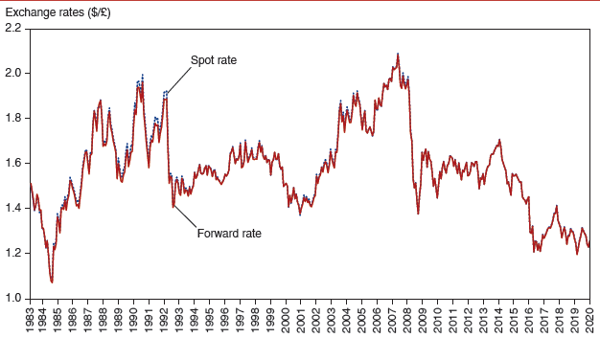
Figure 14.1 Dollar/Pound Spot and Forward Exchange Rates, 1983–2020
Spot and forward exchange rates tend to move in a highly correlated fashion.
Source: Datastream. Rates shown are 90-day forward exchange rates and spot exchange rates, at end of month.
Notes:
The spot and forward exchange rates, with dollar relative to the pound, are graphed versus year, 19 83 to 20 20. The plots for both rates fluctuate between 1.08 and 2.1 and track closely with each other. The plot for forward rate generally rises from (19 83, 1.5) to (19 89, 1.95), falls to (2000, 1.35), rises again to (2006, 2.1), and then falls again to (20 15, 1.48). The plot then rises to (20 18, 1.4) and then falls to (20 20, 1.25). The plot for spot rate generally follows the same path, with some variations, including a peak to 1.98 in 19 89. All values are estimated.

Slide 22
Other Methods of Currency Exchange (1 of 3)
Foreign exchange swaps: a combination of a spot sale with a forward repurchase.
Swaps allow parties to meet each other’s needs for a temporary amount of time and often cost less in fees than separate transactions.
For example, suppose Toyota receives $1 million from American sales, plans to use it to pay its California suppliers in three months, but wants to invest the money in euro bonds in the meantime.

Slide 23
Other Methods of Currency Exchange (2 of 3)
Futures contracts: a contract designed by a third party for a standard amount of foreign currency delivered/received on a standard date.
Contracts can be bought and sold in markets, and only the current owner is obliged to fulfill the contract.

Slide 24
Other Methods of Currency Exchange (3 of 3)
Options contracts: a contract designed by a third party for a standard amount of foreign currency delivered/received on or before a standard date.
Contracts can be bought and sold in markets.
A contract gives the owner the option, but not obligation, of buying or selling currency if the need arises.
A call option gives the owner the right to buy, while a put option gives the right to sell, a specified amount of foreign currency at a specified price at any time prior to the specified expiration date.

Slide 25
The Demand of Currency Deposits (1 of 12)
What influences the demand of (willingness to buy) deposits denominated in domestic or foreign currency?
Factors that influence the return on assets determine the demand of those assets.

Slide 26
The Demand of Currency Deposits (2 of 12)
Rate of return: the percentage change in value that an asset offers during a time period.
The annual return for $100 savings deposit with an
interest rate of 2% is
so that the

Slide 27
The Demand of Currency Deposits (3 of 12)
Real rate of return: inflation-adjusted rate of return, which represents the additional amount of goods and services that can be purchased with earnings from the asset.
The real rate of return for the above savings deposit
when inflation is
After
accounting for the rise in the prices of goods and services, the asset can purchase 0.5% more goods and services after 1 year.

Slide 28
The Demand of Currency Deposits (4 of 12)
If prices are fixed, the inflation rate is 0% and (nominal) rates of return = real rates of return.
Because trading of deposits in different currencies occurs on a daily basis, we often assume that prices do not change from day to day.
A good assumption to make for the short run.

Slide 29
The Demand of Currency Deposits (5 of 12)
Risk of holding assets also influences decisions about whether to buy them.
Liquidity of an asset, or ease of using the asset to buy goods and services, also influences the willingness to buy assets.

Slide 30
The Demand of Currency Deposits (6 of 12)
But we assume that risk and liquidity of currency deposits in foreign exchange markets are essentially the same, regardless of their currency denomination.
Risk and liquidity are only of secondary importance when deciding to buy or sell currency deposits.
Importers and exporters may be concerned about risk and liquidity, but they make up a small fraction of the market.

Slide 31
The Demand of Currency Deposits (7 of 12)
We therefore say that investors are primarily concerned about the rates of return on currency deposits.
Rates of return that investors expect to earn are determined by
interest rates that the assets will earn
expectations about appreciation or depreciation

Slide 32
The Demand of Currency Deposits (8 of 12)
A currency deposit’s interest rate is the amount of a currency that an individual or institution can earn by lending a unit of the currency for a year.
The rate of return for a deposit in domestic currency is the interest rate that the deposit earns.
To compare the rate of return on a deposit in domestic currency with one in foreign currency, consider
the interest rate for the foreign currency deposit
the expected rate of appreciation or depreciation of the foreign currency relative to the domestic currency.

Slide 33
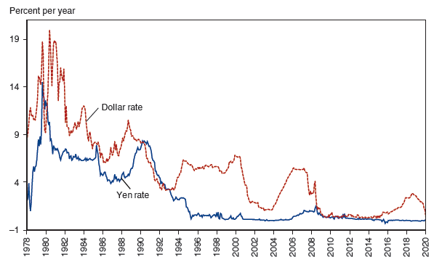
Figure 14.2 Interest Rates on Dollar and Yen Deposits, 1978–2020
Since dollar and yen interest rates are not measured in comparable terms, they can move quite differently over time.
Source: Datastream. The figure shows three-month interest rates.
Notes:
A double line graph plots interest rates for deposits of dollars and yen versus year, 19 78 to 20 20. The plot for dollar rate generally rises from (19 78, 9) to (19 81, 20) and then generally falls through (19 89, 11) and (2000, 7) to (20 04, 1). The plot then rises to (2006, 6), falls to (2009, 2), rises to 20 19, 4), and ends at (20 20, 2). The plot for yen rate generally rises from (19 78, 2) to (19 81, 6) and then generally falls through (19 89, 5) and (2000, 0) to (20 20, 0). All values are estimated.

Slide 34
The Demand of Currency Deposits (9 of 12)
Suppose the interest rate on a dollar deposit is 2%.
Suppose the interest rate on a euro deposit is 4%.
Does a euro deposit yield a higher expected rate of return?
Suppose today the exchange rate is
and the
expected rate one year in the future is
$100 can be exchanged today for
These
after 1 year.
These
are expected to be worth
= $100.88 in 1 year.

Slide 35
The Demand of Currency Deposits (10 of 12)
The rate of return in terms of dollars from investing in euro deposits is
Let’s compare this rate of return with the rate of return from a dollar deposit.
The rate of return is simply the interest rate.
After 1 year the $100 is expected to yield $102:
The euro deposit has a lower expected rate of return: thus, all investors should be willing to dollar deposits and none should be willing to hold euro deposits.

Slide 36
The Demand of Currency Deposits (11 of 12)
Note that the expected rate of appreciation of the euro was
We simplify the analysis by saying that the dollar rate of return on euro deposits approximately equals
the interest rate on euro deposits
plus the expected rate of appreciation of euro deposits

Slide 37
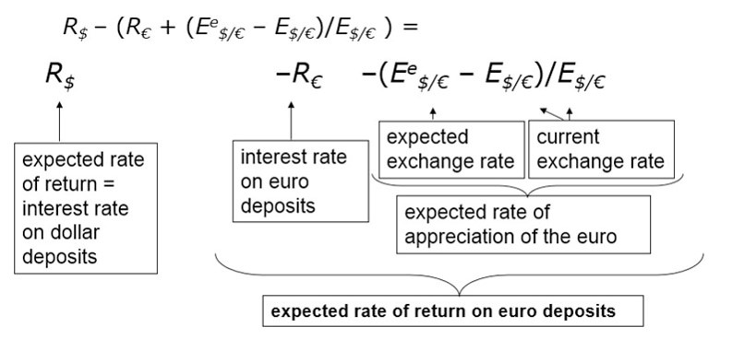
The Demand of Currency Deposits (12 of 12)
The difference in the rate of return on dollar deposits and euro deposits is
Notes:
The breakdown of this equation is as follows, in order: R sub dollars is the expected rate of return = interest rate on dollar deposits. This combined with everything that follows is the expected rate of return on euro deposits. Minus R sub euros is the interest rate on euro deposits. The expected exchange rate is minus open parenthesis E to the power of lowercase E sub the division of dollars by sub euros. The current exchange rate is minus E sub the division of dollars by euros, close parenthesis, divided by E sub the division of dollars by euros. Together, these are the expected rate of appreciation of the euro.

Slide 38
Model of Foreign Exchange Markets (1 of 6)
Construct model of foreign exchange markets using:
the demand of (rate of return on) dollar-denominated deposits
and the demand of (rate of return on) foreign currency– denominated deposits

Slide 39
Table 14.3 Comparing Dollar Rates of Return on Dollar and Euro Deposits
Blank | Dollar Interest Rate | Euro Interest Rate | Expected Rate of Dollar Depreciation Against Euro | Rate of Return Difference between Dollar and Euro Deposits
Case | R sub $ | R sub euro | start fraction upper E to the lower e power, sub $ per euro minus upper E sub $ per euro over upper E sub $ per euro end fraction | R sub $ minus R sub euro minus start fraction upper E to the lower e power, sub $ per euro minus upper E sub $ per euro over upper E sub $ per euro end fraction
1 | 0.10 | 0.06 | 0.00 | 0.04
2 | 0.10 | 0.06 | 0.04 | 0.00
3 | 0.10 | 0.06 | 0.08 | Negative 0.04
4 | 0.10 | 0.12 | Negative 0.04 | 0.02

Slide 40
Model of Foreign Exchange Markets (2 of 6)
Model in equilibrium when deposits of all currencies offer the same expected rate of return: interest parity.
Interest parity implies that deposits in all currencies are equally desirable assets.
Interest parity implies that arbitrage in the foreign exchange market is not possible.
Interest parity says:

Slide 41
Model of Foreign Exchange Markets (3 of 6)
Why should the interest parity condition hold?
Suppose it did not. Suppose
Then no investor would want to hold euro deposits, driving down the demand and price of euros.
Then all investors would want to hold dollar deposits, driving up the demand and price of dollars.
The dollar would appreciate and the euro would depreciate, increasing the right side until equality was achieved.

Slide 42
Model of Foreign Exchange Markets (4 of 6)
How do changes in the current exchange rate affect the expected rate of return of foreign currency deposits?
Depreciation of the domestic currency today lowers the expected rate of return on foreign currency deposits.
When the domestic currency depreciates, the initial cost of investing in foreign currency deposits increases, thereby lowering the expected rate of return of foreign currency deposits.

Slide 43
Model of Foreign Exchange Markets (5 of 6)
Appreciation of the domestic currency today raises the expected return of deposits on foreign currency deposits.
When the domestic currency appreciates, the initial cost of investing in foreign currency deposits decreases, thereby lowering the expected rate of return of foreign currency deposits.

Slide 44
Table 14.4 Today’s Dollar/Euro Exchange Rate and the Expected Dollar Return on Euro Deposits When upper E to the lower e power, sub $ per euro minus upper E sub $ per euro = $1.05 per Euro
Today’s Dollar/Euro Exchange Rate | Interest Rate on Euro | Expected Dollar Depreciation Rate against Euro | Expected Dollar Return on Euro Deposits
E sub $ per euro | R sub euro | start fraction upper 1.05 minus upper E sub $ per euro over upper E sub $ per euro end fraction | R sub euro + start fraction 1.05 minus upper E sub $ per euro over upper E sub $ per euro end fraction
1.07 | 0.05 | Negative 0.019 | 0.031
1.05 | 0.05 | 0.00 | 0.05
1.03 | 0.05 | 0.019 | 0.069
1.02 | 0.05 | 0.029 | 0.079
1.00 | 0.05 | 0.05 | 0.10

Slide 45
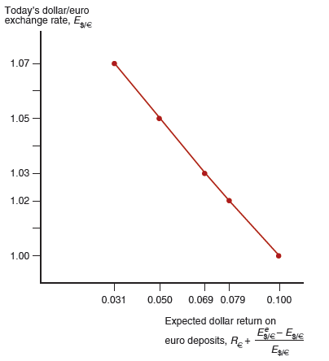
Figure 14.3 The Relation Between the Current Dollar/Euro Exchange Rate and the Expected Dollar Return on Euro Deposits
Given that
an appreciation of the dollar against
the euro raises the expected return on euro deposits, measured in terms of dollars.
Notes:
The plot falls from through 5 points from right to left: as follows: (0.031, 1.07), (0.048, 1.05), (0.069, 1.03), (0.79, 1.02) and (0.1, 1). All values estimated.

Slide 46
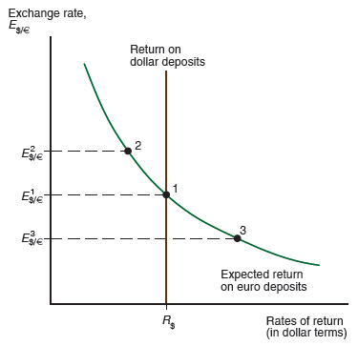
Figure 14.4 Determination of the Equilibrium Dollar/Euro Exchange Rate
Equilibrium in the foreign exchange market is at point 1, where the expected dollar returns on dollar and euro deposits are equal.
Notes:
The plot falls with decreasing steepness, noted as the expected return on euro deposits. 3 points are plotted on the curve with 3 different exchange rates. From the highest on the curve to the lowest, points are 2, 1, and 3. Point 1 is the return on dollar deposits with coordinates (R sub dollars, Exchange rate super 1).

Slide 47
Model of Foreign Exchange Markets (6 of 6)
The effects of changing interest rates:
An increase in the interest rate paid on deposits denominated in a particular currency will increase the rate of return on those deposits.
This leads to an appreciation of the currency.
Higher interest rates on dollar-denominated assets cause the dollar to appreciate.
Higher interest rates on euro-denominated assets cause the dollar to depreciate.

Slide 48
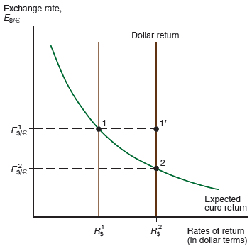
Figure 14.5 Effect of a Rise in the Dollar Interest Rate
A rise in the interest rate offered by dollar deposits from
causes the dollar to appreciate from
Notes:
The plot falls with decreasing steepness through point 1, (R sub dollars super 1, E sub dollars to euros, super 1). The dollar return is shifted from R sub dollars super 1 to R sub dollars super 2, and the plot passes through and point 2, (R sub dollars super 2, E sub dollars to euros, super 2). Point 1 prime is above point 2, at y = E sub dollars to euros super 1.

Slide 49
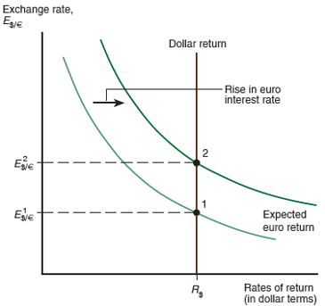
Figure 14.6 Effect of a Rise in the Euro Interest Rate
A rise in the interest rate paid by euro deposits causes the dollar to depreciate from
(This figure also describes the effect of a rise in the
expected future
exchange rate.)
Notes:
The plot falls with decreasing steepness, noted as the euro return, through point 1, at (R sub dollars, E sub dollars to euros super 1). The plot is shifted to the right to indicate a rise in euro interest rate. The shifted plot falls through point 2, at (R sub dollars, E sub dollars to euros super 2).

Slide 50
The Effect of Changing Expectations on the Current Exchange Rate
If people expect the euro to appreciate in the future, then euro-denominated assets will pay in valuable euros, so that these future euros will be able to buy many dollars and many dollar-denominated goods.
The expected rate of return on euros therefore increases.
An expected appreciation of a currency leads to an actual appreciation (a self-fulfilling prophecy).
An expected depreciation of a currency leads to an actual depreciation (a self-fulfilling prophecy).

Slide 51
What Explains Carry Trade?
International investors frequently borrow low-interest currencies and buy high-interest currencies, with results that can be profitable over long periods—this activity is called carry trade.
The extent of carry trade positions can become very large when sizable international interest differentials open up. Is the prevalence of the carry trade evidence that interest parity is wrong?
While interest parity does not hold exactly in practice, in part because of the risk and liquidity factors mentioned earlier, economists are still trying to understand if the carry trade requires additional explanation.
The high-interest currencies that carry traders target may experience abrupt crashes.

Slide 52
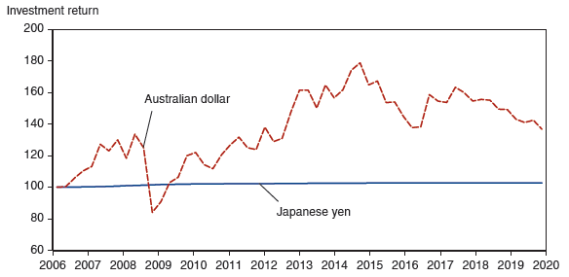
Figure 14.7 Cumulative Total Investment Return in Australian Dollars Compared with Japanese Yen, 2006–2020
The Australian dollar-yen carry trade has been profitable on average but is subject to sudden large reversals, as in 2008.
Source: Quarterly Japanese yen/Australian dollar exchange rate, 90-day Australia bank bill rate, and 90-day Japan certificate of deposit rate from F R E D database. The chart compares the cumulative value over time of a
investment in Japanese interest-bearing 90-day bonds, rolled over every quarter, with the same yen investment converted into Australian dollars, invested in 90-day Australian bonds and rolled over every quarter, and then converted back into yen at the end of the investment period.
Notes:
The double line graph depicts cumulative investment return versus year, 2006 to 20 20, with plots for the Australian dollar and the Japanese yen. The plot for Japanese yen remains almost entirely flat, rising from (2006, 100) to (20 20, 101). The plot for the Australian dollar generally rises from 100 in 2006, to 210 in at the end of 2007. A dip in 2008 drops to 125. The dollar then rises to 250 in 20 13, drops to 210 in 20 16, rises to 160 in 20 18, and dips to 135 in 20 20. All values are estimated.

Slide 53
Forward Exchange Rates and Covered Interest Parity (1 of 5)
Covered interest parity (C I P) relates interest rates across countries and the rate of change between forward exchange rates and the spot exchange rate:
where
is the forward exchange rate.
It says that rates of return on dollar deposits and “covered” foreign currency deposits are the same.
How could you earn a risk-free return in the foreign exchange markets if covered interest parity did not hold?
Covered positions using the forward rate involve little risk.

Slide 54
Forward Exchange Rates and Covered Interest Parity (2 of 5)
For example, suppose the 1-year forward price of euros in terms of dollars
is
and the spot exchange rate is
per euro.
If
compare the rate of return on a covered euro deposit to a 10%
rate of return on a dollar deposit
A
deposit costs $1.05 today and is worth
after 1 year.
Selling
forward today at the forward exchange rate $1.113 per
euro yield a dollar value after 1 year of
The rate of return on the covered purchase of a euro deposit is
or 10.3%, is greater than a 10% rate
of return on a dollar deposit and covered interest parity fails.

Slide 55
Forward Exchange Rates and Covered Interest Parity (3 of 5)
The forward premium on euros against dollars (also called the forward discount on dollars against euros) is
Using this terminology, the covered interest parity condition becomes:
The interest rate on dollar deposits equals the interest rate on euro deposits plus the forward premium on euros against dollars.

Slide 56
Forward Exchange Rates and Covered Interest Parity (4 of 5)
Figure 14-8 graphs the difference between dollar interbank interest rates and the covered return to investing in three foreign interbank markets.
Big deviations from C I P emerged around the time of the worldwide banking crisis in 2007–2008. C I P did not reestablish itself after the crisis passed.
The deviations from C I P tend to be negative, implying that it would be profitable to arbitrage by borrowing dollars, selling them for foreign currencies, and then investing the proceeds in foreign money markets while selling the proceeds forward to complete the round trip out of dollars and back

Slide 57
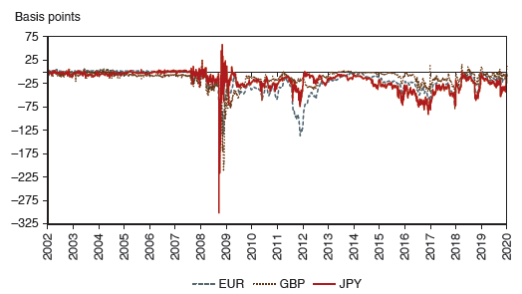
Figure 14.8 U.S. Dollar Three-Month Interest Rate Less Covered Rate on Three-Month Foreign Bank Deposits
Covered interest parity held well up until the financial crisis that started in 2008, but it has not held closely since then. The three non-U.S. investment currencies shown are the euro, pound, and yen.
Notes:
The triple line graph depicts basis points versus year, 2002 to 20 20, with plots for the euro, pound, and yen. The plot for yen remains almost entirely flat, rising from (2002, 0) to (2007, 0), then makes a sudden dip at (2008, negative 300) and fluctuates in the range of negative 75 to negative 25 from 20 10 to 20 20. The plot for the pound is generally a flat line around 0 basis points from 2002 to 20 20, with slight fluctuations at times reaching negative 25. The plot for euro generally rises from 0 in 2002 to negative 25 at the end of 2008. A dip in 20 12 drops to negative 125. The euro then rises to 0 in 20 13 and then drops to negative 25 in 20 17 and again rises to 0 in 20 20. All values are estimated.

Slide 58
Forward Exchange Rates and Covered Interest Parity (5 of 5)
By comparing the uncovered interest parity (UIP) condition,
with the covered interest parity condition, you will find that both conditions can be true at the same time only if the 1-year forward rate quoted today equals the spot exchange rate
people expect to materialize a year from today:
Covered transactions do not involve exchange rate risk, whereas uncovered transactions do.

Slide 59
Summary (1 of 4)
An exchange rate is the price of one country’s currency in terms of another country’s currency.
It enables us to translate different countries’ prices into comparable terms.
Depreciation of a currency means that it becomes less valuable and goods denominated in it are less expensive: exports are cheaper and imports more expensive.
Appreciation of a currency means that it becomes more valuable and goods denominated in it are more expensive: exports are more expensive and imports cheaper.

Slide 60
Summary (2 of 4)
Commercial and investment banks that invest in deposits of different currencies dominate the foreign exchange market.
Expected rates of return are most important in determining the willingness to hold these deposits.
Rates of return on currency deposits in the foreign exchange market are influenced by interest rates and expected exchange rates.

Slide 61
Summary (3 of 4)
Equilibrium in the foreign exchange market occurs when rates of returns on deposits in domestic currency and in foreign currency are equal: interest rate parity.
An increase in the interest rate on a currency’s deposit leads to an increase in its expected rate of return and to an appreciation of the currency.

Slide 62
Summary (4 of 4)
An expected appreciation of a currency leads to an increase in the expected rate of return for that currency, and thus leads to an actual appreciation.
Covered interest parity says that rates of return on domestic currency deposits and “covered” foreign currency deposits using the forward exchange rate are the same.

Slide 63

Copyright
This work is protected by United States copyright laws and is provided solely for the use of instructors in teaching their courses and assessing student learning. Dissemination or sale of any part of this work (including on the World Wide Web) will destroy the integrity of the work and is not permitted. The work and materials from it should never be made available to students except by instructors using the accompanying text in their classes. All recipients of this work are expected to abide by these restrictions and to honor the intended pedagogical purposes and the needs of other instructors who rely on these materials.

